Slide 1
Time Value of Money
Chapter 23.5 -23.9
ChEn 4253
Terry A. Ring

Slide 2
Examples of Time Value of Money
Saving Account
  Interest increases the amount with time
Loan
  Payment amount
Retirement Annuity
  Pays out constant amount per month
  Pays out an amount that increases with inflation per month

Slide 3
Interest
% interest
Time over which it is compounded
  Day, Week, Month, quarter or year
Two types of interest
  Simple Interest – rarely used
  Compound Interest
Be careful with interest
  Credit card statement 1.9% per month = 22.8% per year simple interest, I_{S}=ni
  Credit card statement 1.9% per month = 25.34% per year compound interest, I_{C}=[(1+i)^{n}-1]

Slide 4
Some Nomenclature
F= Future value
P=Present value
i= interest rate for interest period
r=nominal interest rate (%/yr)
n_{y}= no. of years
n= no. of interest periods

Slide 5
Interest
Simple interest
  F=(1+n*i)P
Compound Interest
  F=(1+i)^{n}P
    Allows present or future value to be determined
    Can be inverted to give present value associated with a discount factor
Nominal Interest (simple interest when period is not 1 yr)
  r =i*m
    m= periods per year
Effective Interest Rate (compound interest when period is not 1 yr)
  i_{eff}= (1+r/m)^{m}-1
Continuous Compounding
  i_{eff=}=exp(r) - 1

Slide 6
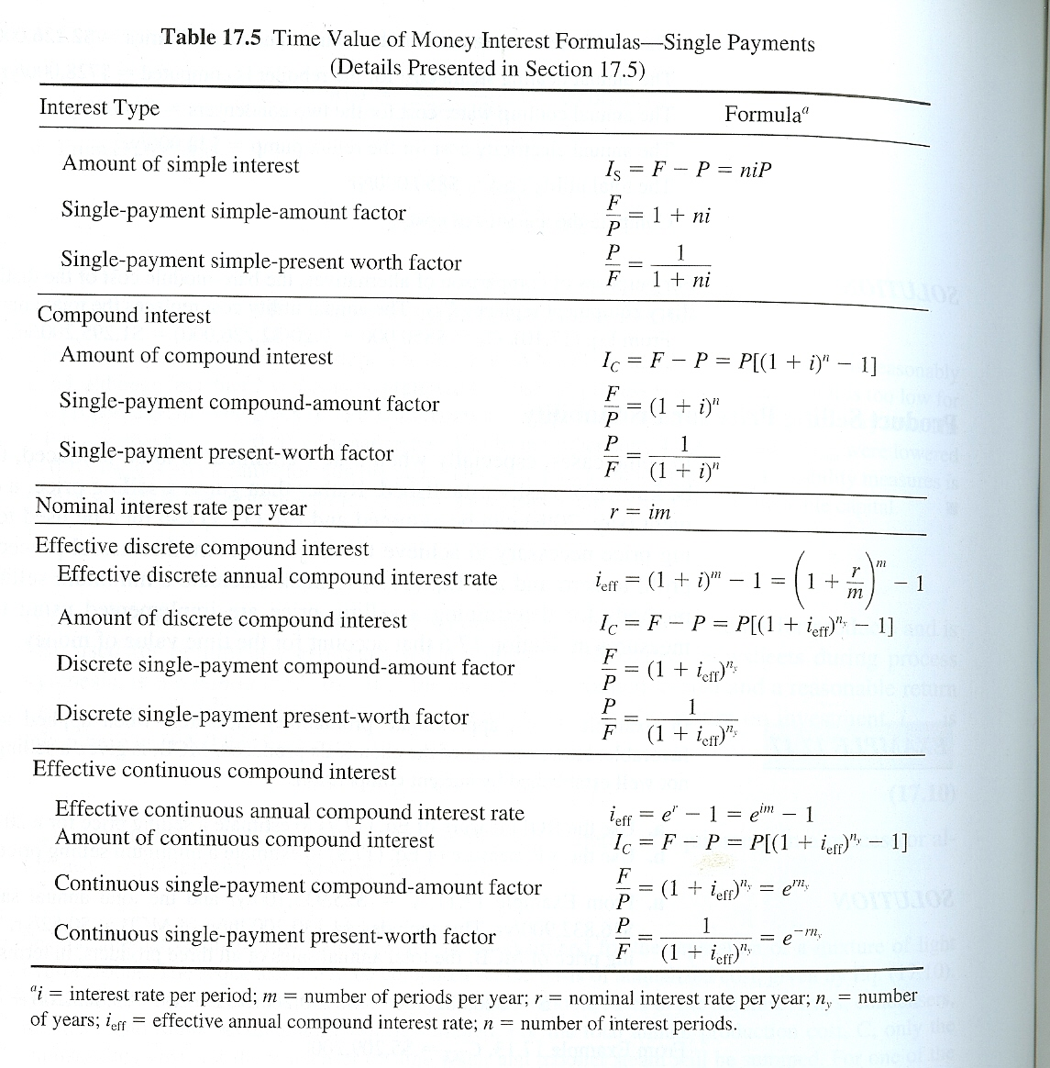

Slide 7
Present Value/Future Value
Determine the Present Value of an investment (or payment) in the Future.
  You are due a $10,000 signing bonus to be paid to you after you have completed 2 yrs of service with your new company. What is the present value of that bonus given 7% interest?
Determine the Future Value of an investment made today
  What is $10,000 worth if kept in a bank for 10 years at 3%/yr (compound) interest
  Present value of retirement fund is $300,000. What will it be worth when I am 64 years old.

Slide 8
Student Loan
Get $10,000 in August 2009. Collects interest at 5% until graduation August 2013. What amount do you owe upon graduation?
F=(1+i)^{n}P =(1+0.05)⁴ $10,000=$12,160

Slide 9
Annuity
Series of Single payments, A, made at fixed time periods
Examples – Installment Loans
  Student Loan Repayment
  Mortgage Loan
  Car Loan
  Retirement – old system
Assumes periodic Compound Interest and payment at end of first period
  discrete uniform-series compound-amount factor
  F=A[(1+i)^{n}-1]/i
Present Worth of Annuity
  P=F/(1+i)^{n}

Slide 10
Annuity Types
Mix and match interest and payment schedules
Compound Interest
  Discrete – monthly, quarterly, semi-annually annually
  Continuous
Payments
  Discrete – monthly, quarterly, semi-annually, annually
  Continuously

Slide 11
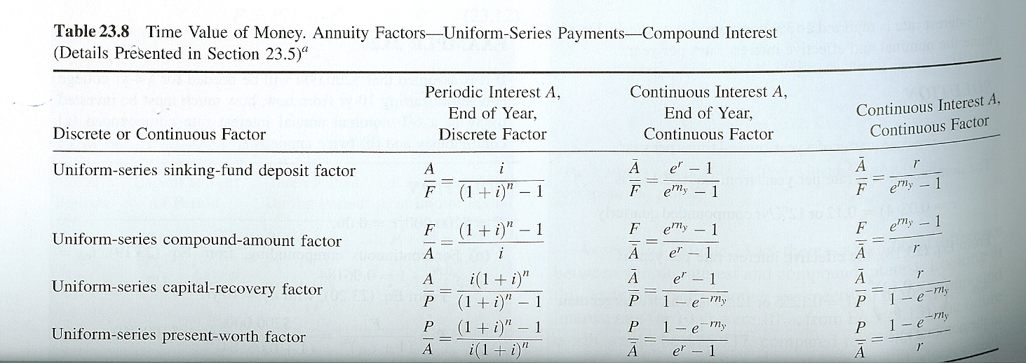
Annuity Table
i=r/m=periodic interest rate, A = payment per interest period, n=mn_{y} number of interest periods, Ā=pÂ=total annual payments per year, p=payments per year, r nominal annual interest rate.

Slide 12
See Article
Engineering Economics-FE Exam.pdf

Slide 13
Payment for Student Loan
Loan amount =$12,160
What is payment if annual interest rate is 5% and loan is to be paid off over 10 years using monthly payments?
Do this for practice example for practice. Answer is $128.98 (see next slide)
Principle is being charged interest each month
Each payment pays interest and lowers principle so interest is less
Fix payment
  Shifts from mostly paying interest to
  Mostly paying principle as time goes on

Slide 14
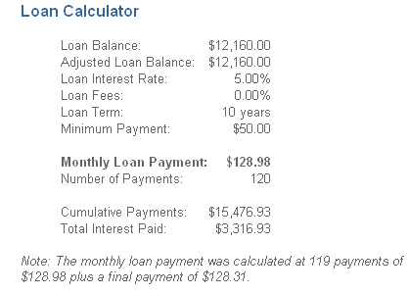
Check Loan Repayment

Slide 15
Retirement Annuity
Monthly payments into 401k Account $200/mo at 5%/y interest. After working 25 years, what is value?
    A= 12*$200
    N=25
    i=0.05
    F=A[(1+i)^{n}-1]/i= $1,145,000
    Present value of all that investment on your first day of work
    P=F/(1+i)^{n}=$33,830

Slide 16
Compare two alternative pumps
Pump A Pump B
Installed Cost $ 20,000.00 $ 25,000.00
Yearly maintenance $ 4,000.00 $ 3,000.00
Service Life (yr) 2 3
Salvage Value $ 500.00 $ 1,500.00
Interest Rate 6.8% 6.8%
Life of Plant (yr) 6 6

Slide 17
Determine Present Value
Each Purchases
Each Sale of Salvage Equipment
All Annual Payments to for Maintenance
Add them up
  Purchases are negative
  Sales are positive

Slide 18
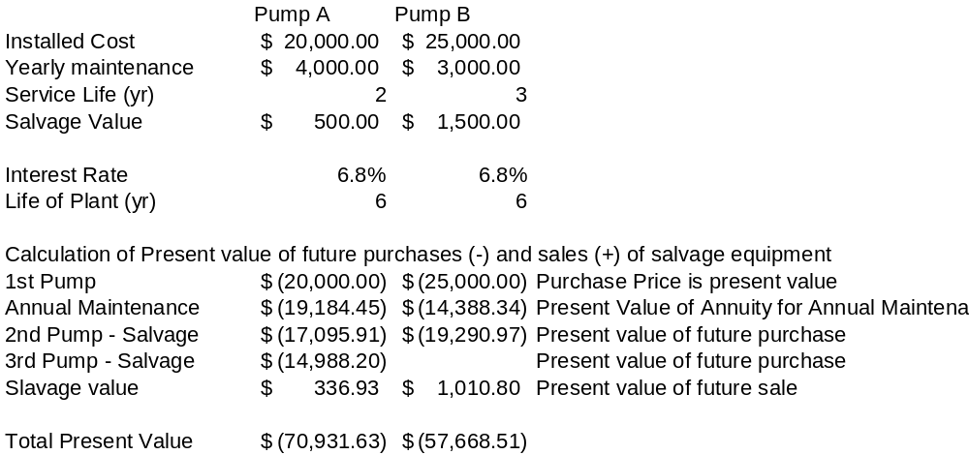

Slide 19
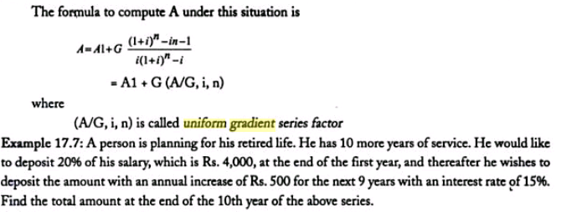
Uniform Gradient
Rs = Rupee
A= equivalent annual payment for an annuity

Slide 20
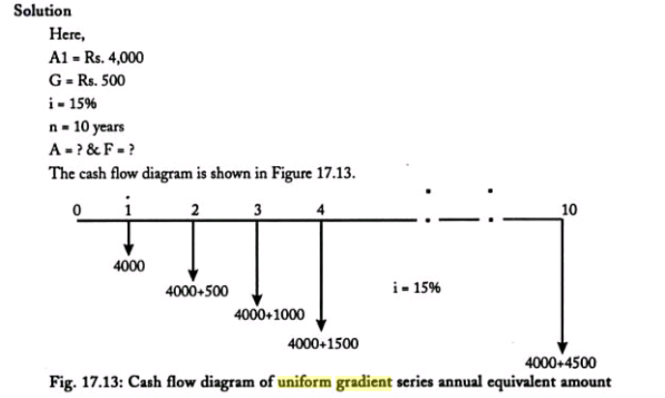

Slide 21
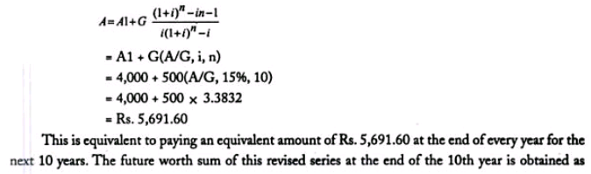
Equivalent Annual Payment

Slide 22
Future Value
A=Rs. 5691.60
i=15%/yr
N=9yr
F=A[(1+i)^{n}-1]/I = Rs 1,155,62.25
Use this where inflation is figured into the annual maintenance cost of pumps

